Slide 1


library(dplyr)
rladies_global %>% filter(city == 'Bari')
Manipolare i dati con
Tidyverse

Slide 2


Hello!
Welcome to R-Ladies Bari

Slide 3
1.
Introduction
R language, RStudio

Slide 4
Three things
you’ll need to install
Install R -- this is the open-source programming language we’ll use (download via CRAN -- Comprehensive R Archive Network)
1.
Install RStudio -- this is the most popular IDE for R and will make your life a lot easier (download from rstudio.com/download)
2.
Install the tidyverse -- this is the group of packages we’ll use within R to work with data.
Install with one line of code in R: install.packages(“tidyverse”)
3.

Slide 5
2.
Manipolare i dati con Tidyverse

Slide 6
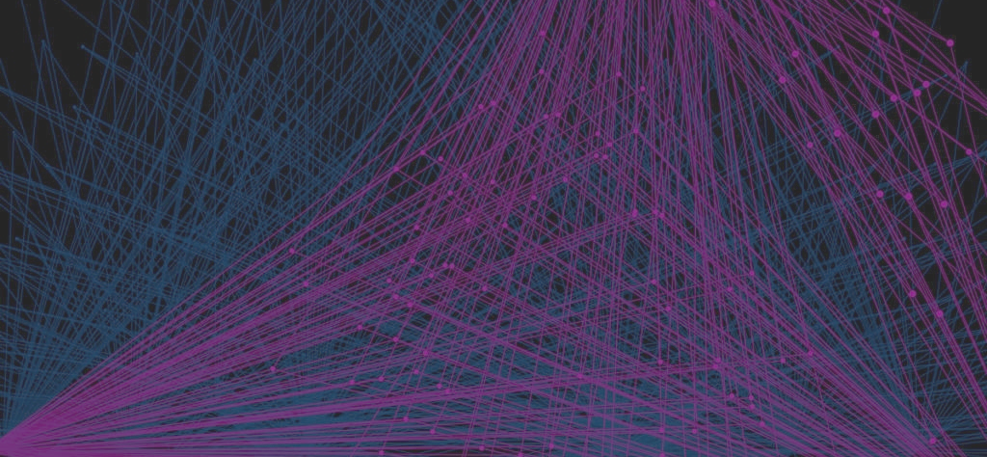

The data science process (tidied)
Notes:
Tidy ordinare

Slide 7
What is
the tidyverse?
Collection of R packages based on tidy data principles
Designed to work together
An easier way to code!
AKA “Hadleyverse” (most packages written by Hadley Wickham)

Slide 8
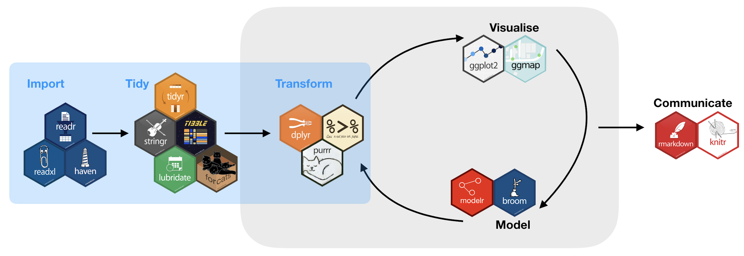
The data science process
with tidyverse
https://www.tidyverse.org/
Notes:
purrr enhances R’s functional programming (FP) toolkit by providing a complete and consistent set of tools for working with functions and vectors. Once you master the basic concepts, purrr allows you to replace many for loops with code that is easier to write and more expressive.
PURRR: provides very consistent and natural methods for iterating on R objects,

Slide 9
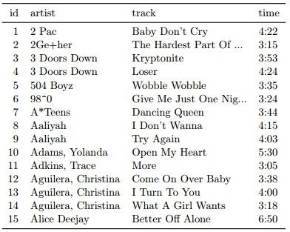
What is
tidy data?
Each variable is a column
Each observation is a row
Each type of observational unit is a table

Slide 10

3.
dplyr
Let’s start with the first set of slides

Slide 11

dplyr
grammar of data manipulation
mutate() to create new variables from existing ones
select() picks variables based on their names
filter() allows pointed selection based on given criteria
summarise() reduces multiple values down to a single summary
arrange() changes the ordering of rows
group_by() performs any of the above on a group-by-group basis

Slide 12
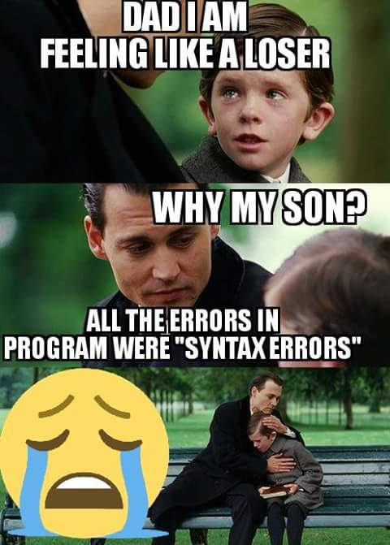
dplyr syntax
All calls to dplyr verbs follow the same format:
The first argument is a dataframe
The subsequent arguments describe what to do to that dataframe, using unquoted variable names.
Each call returns a new dataframe (rather than overwriting the ‘old’ one)
Example:
filter(dataset_name,
name == “Francesca”)

Slide 13
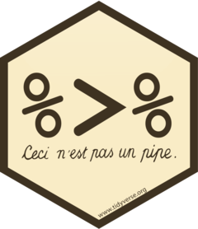
What is magrittr?
Simplifying R code with pipes (%>%)
Easy way to pass data through functions without nesting
First argument of each function is “piped” in to reduce redundancy

Slide 14
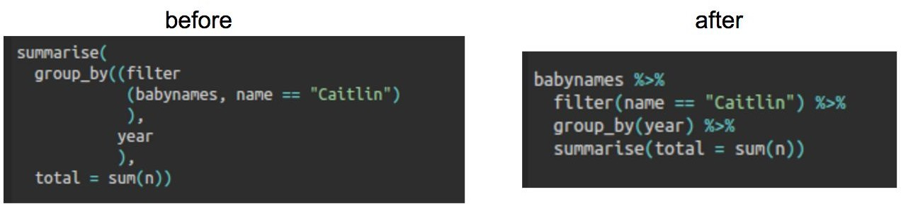
dplyr + magrittr example

Slide 15

Quick aside: iris dataset
Included in R (iris to view)
150 observations of 5 variables:
iris type, sepal length, sepal width, petal length and petal width

Slide 16

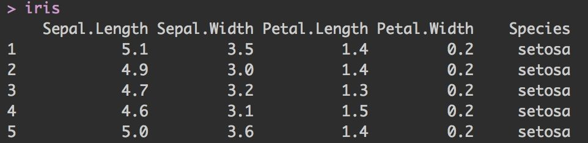
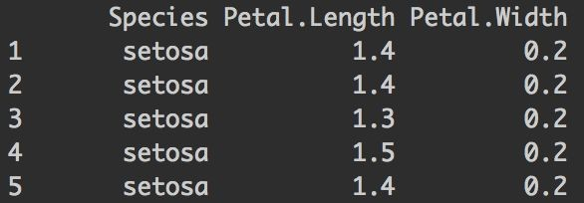
select()
Picks variables based on their names
First argument is dataframe; subsequent arguments represent columns to select
iris %>% select(Species, Petal.Length, Petal.Width)

Slide 17
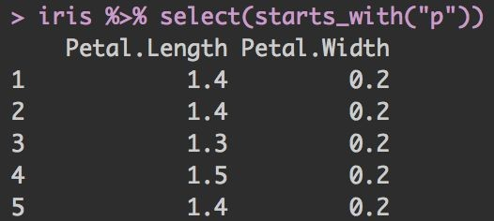
select() +
helper functions
Helper functions you can use within select():
starts_with(“a”) matches names that begin with “a”
ends_with(“z”) matches names that begin with “z”
contains(“lady”) matches names that contain “lady”
matches(<regex>) allows you to do regex matching on names

Slide 18

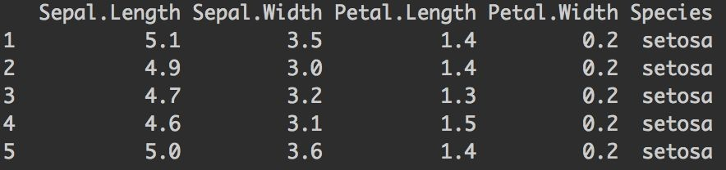
filter()
Allows pointed selection based on given criteria
First argument is the dataframe, subsequent arguments are expressions used to filter the dataframe
iris %>% filter(Species ==“setosa”)
nrow = 150
nrow = 50

Slide 19
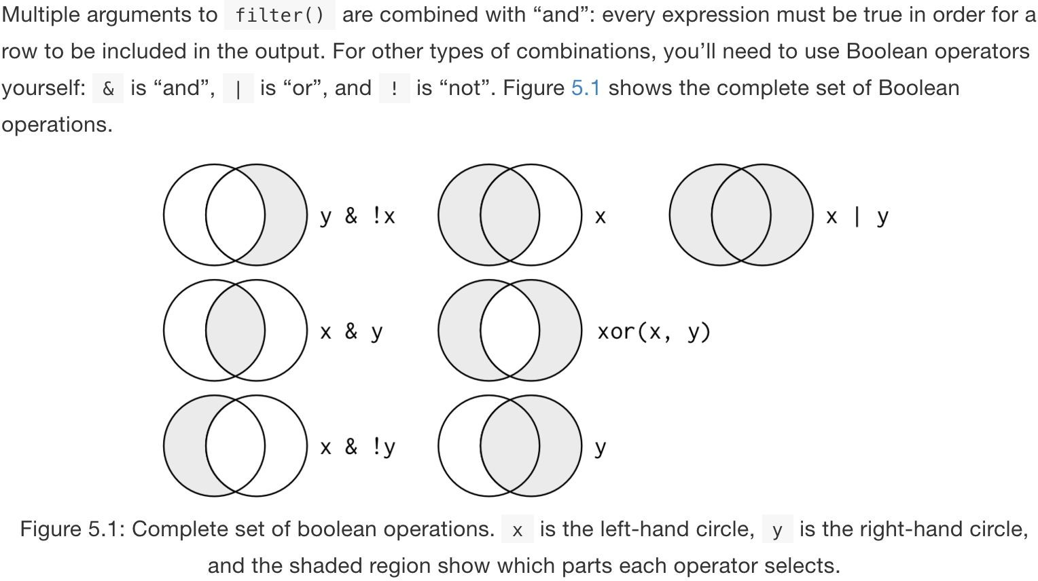
filter() + booleans

Slide 20

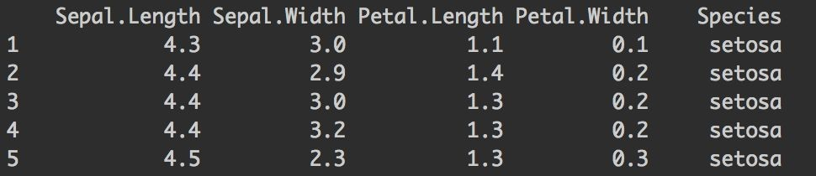
arrange()
Changes the ordering of rows
First argument is the dataframe, subsequent arguments are columns and/or expressions used to re-arrange the dataframe
Note: default is ascending order, and NA’s are always at the end
iris %>% arrange(Sepal.Length, Sepal.Width)

Slide 21
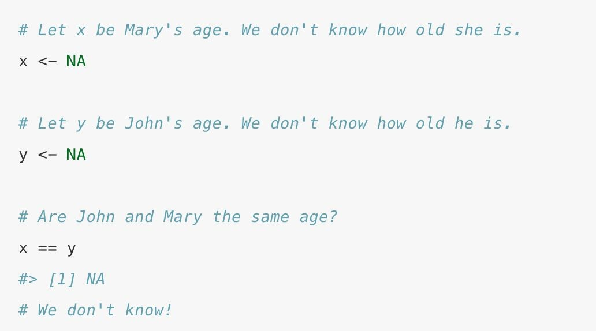
Quick aside: Missing values
NA represents a missing (unknown) value
Comparisons involve unknown values typically result in unknown values
To see whether a value is missing, use is.na()
filter()only includes rows where the condition is true (not false or NA)

Slide 22

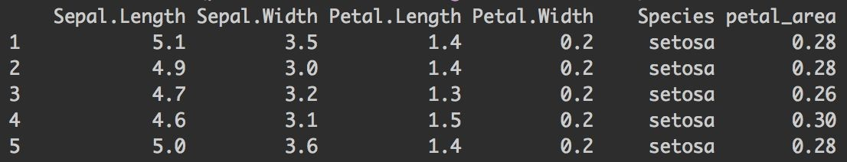
mutate()
Creates new variables from existing ones
Note: columns created with mutate() are always added to end of dataset
iris %>% mutate(petal_area = Petal.Length * Petal.Width)

Slide 23
mutate()
Useful functions
+ Arithmetic operators (+, -, *, /, ^)
+ Log functions (like log10())
+ Offsets like lead() and lag()
+ Logical comparisons (<, <=, >, >=, !=)
+ Ifelse() statements (if this, then this, else this)
+ Cumulative and rolling aggregates
+ Ranking (like ntile())

Slide 24
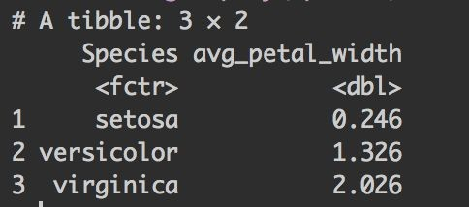
group_by() and
summarise()
+ group_by applies dplyr verbs by group
+ summarise reduces multiple values down to a single summary
iris %>%
group_by(Species) %>% summarise(avg_petal_width = mean(Petal.Width)

Slide 25
summarise()
Useful functions
+ Counts (n(), n_distinct())
+ Measures of location (mean(), median())
+ Measures of spread (sd(), IQR())
+ Measures of position (first(), last())

Slide 26
Tips & Tricks
If you don’t have the result of a dplyr chain to a dataframe, it will print
If you want to print and save, wrap assignment in parenthesis
Example: (iris_names <- iris %>% filter(Species == “setosa”))
rename() is a cool function to clean up messy column names
After grouping with group_by(), you can ungroup() to remove groupings
There is a cheat sheet for data wrangling!

Slide 27
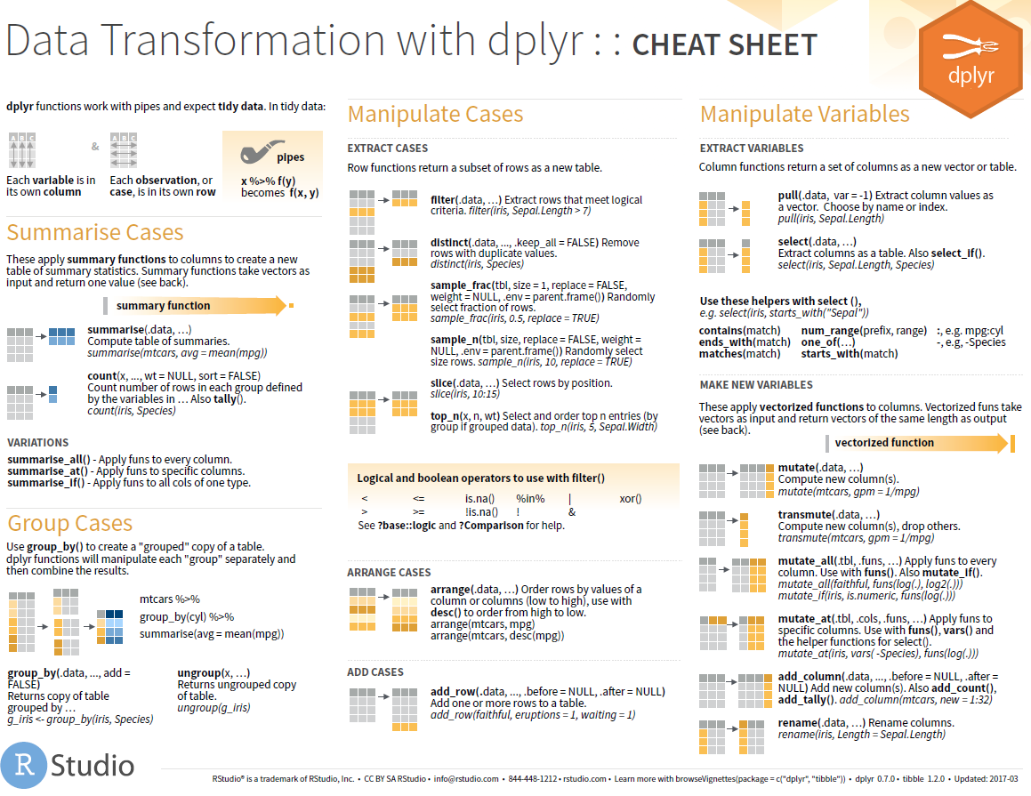
Cheat sheet for data wrangling

Slide 28
4.
Wrap-up
Announcements, upcoming events, etc.

Slide 29
R-Ladies Bari E-Learning
Esercitazioni gratuite
https://www.datacamp.com/courses/introduction-to-the-tidyverse
https://www.kaggle.com/rtatman/manipulating-data-with-the-tidyverse

Slide 30

R-Ladies Bari Upcoming Events

